Slide 1
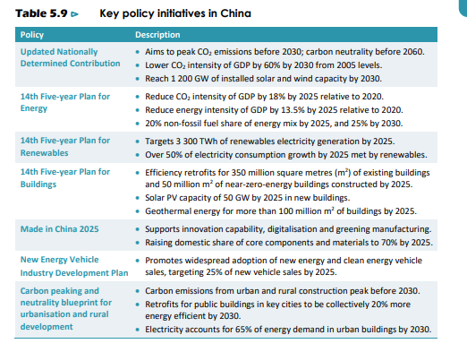
IEA WEO 2023

Slide 3
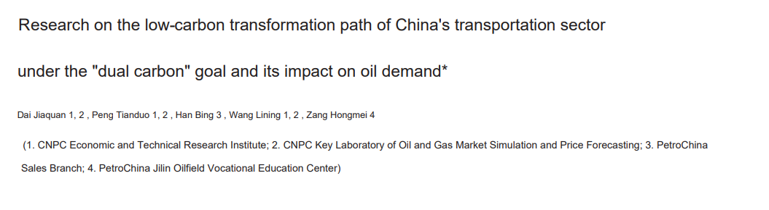
The following graphs are all from:

Slide 4
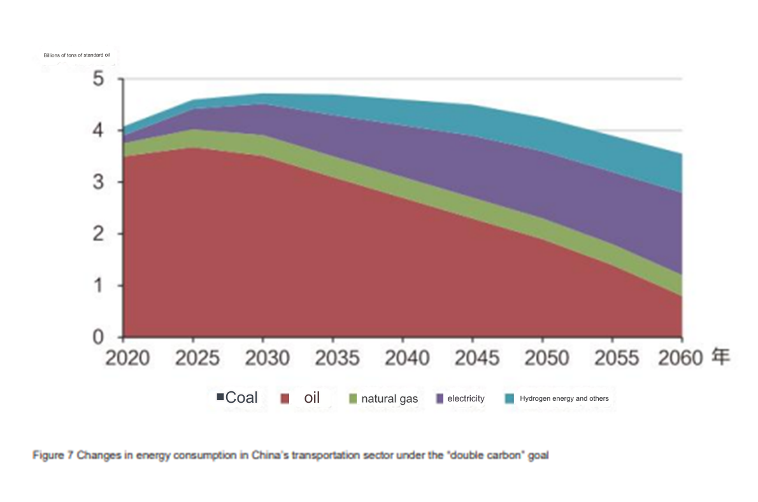

Slide 5
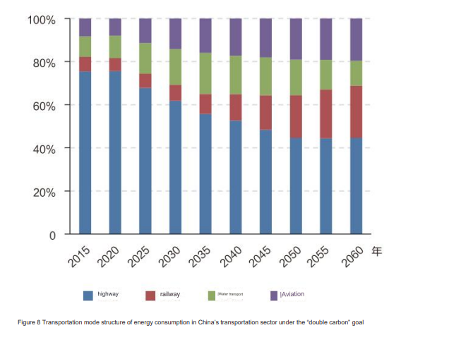
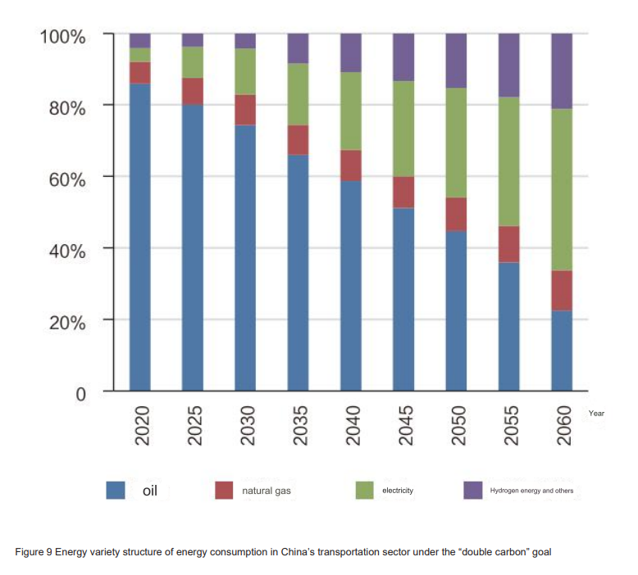

Slide 6
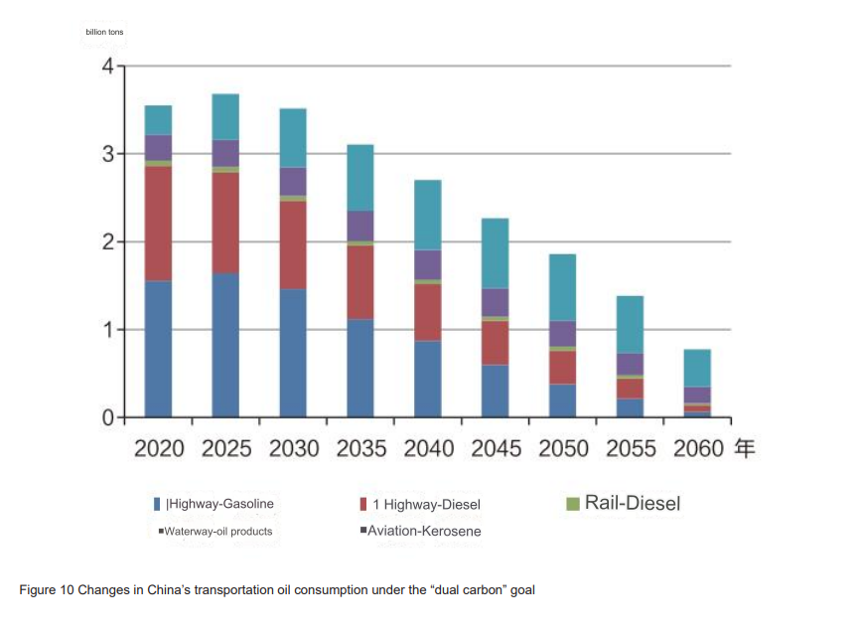

Slide 7
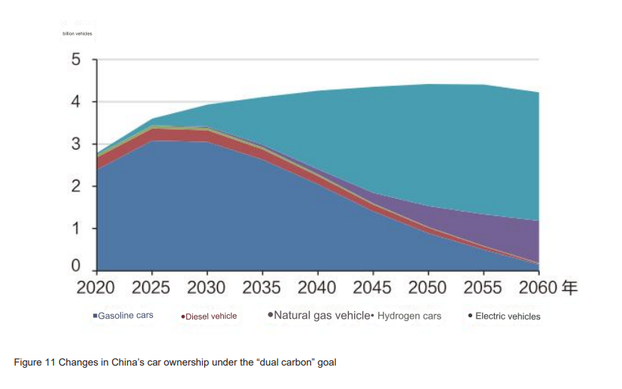

Slide 8
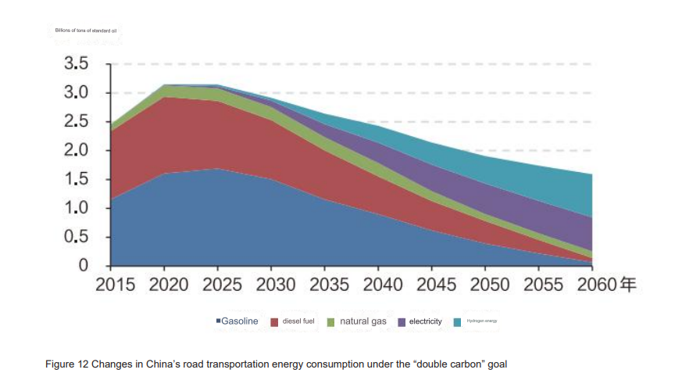

Slide 9
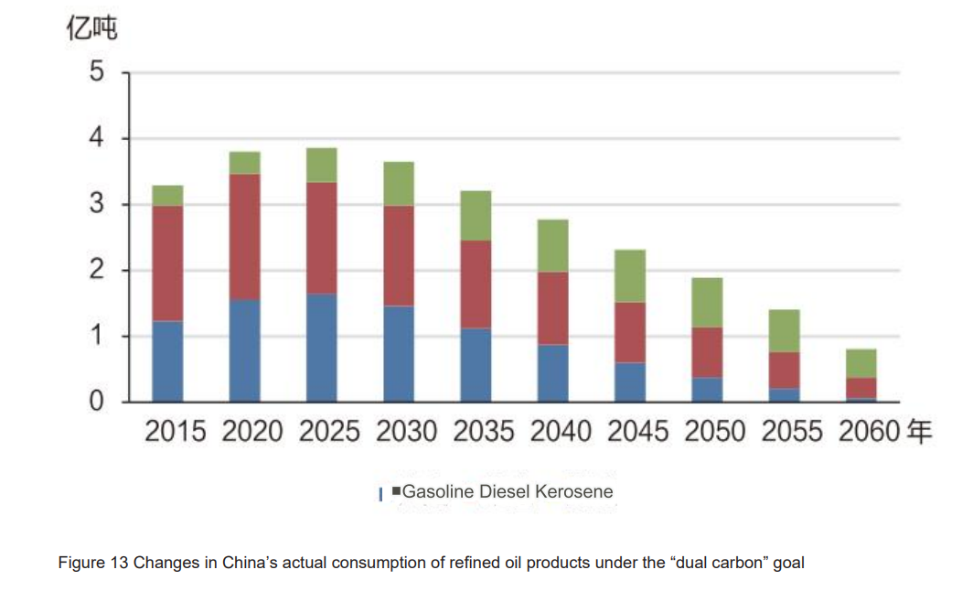

Slide 10
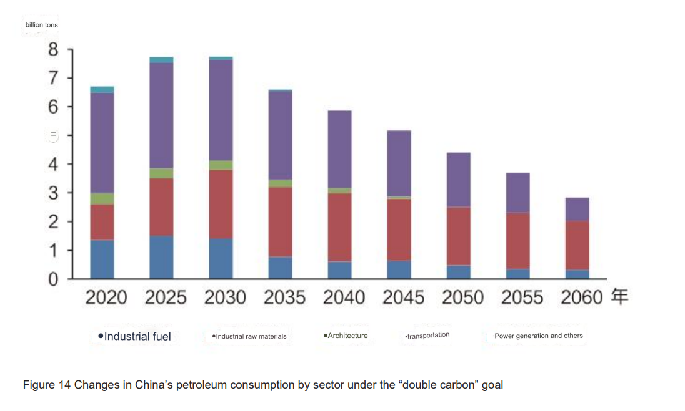

Slide 11
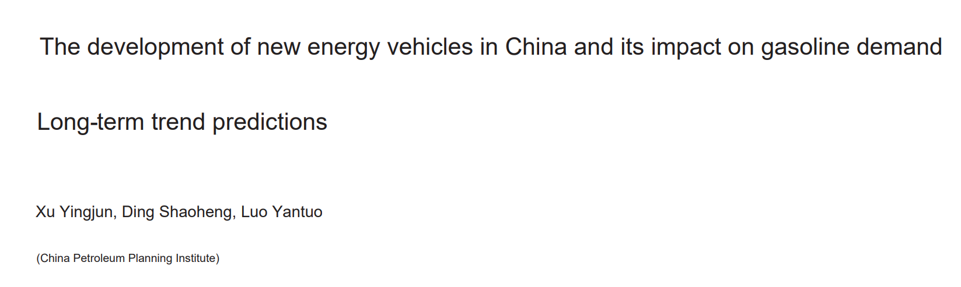
The following graphs are all from:

Slide 12
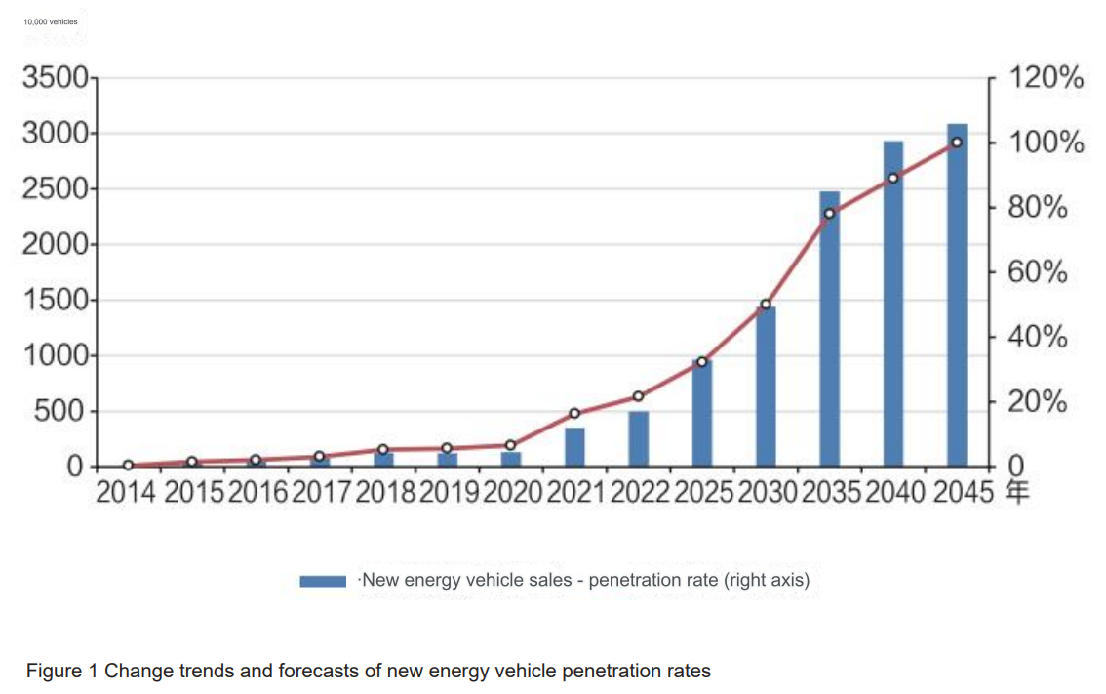

Slide 13
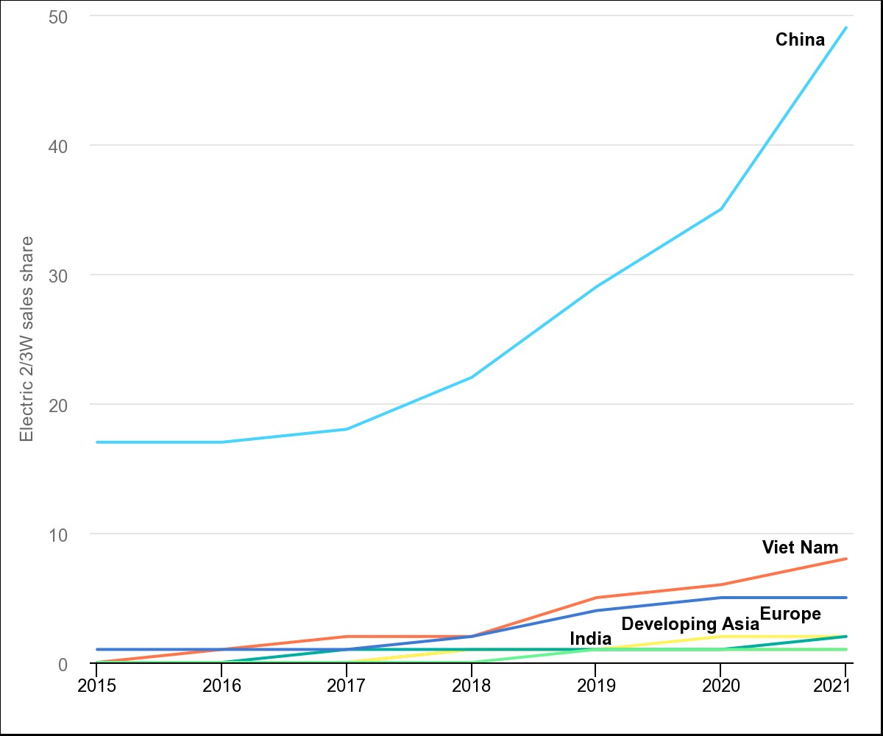
https://www.iea.org/data-and-statistics/charts/electric-two-three-wheeler-sales-share-by-region-2015-2021

Slide 14
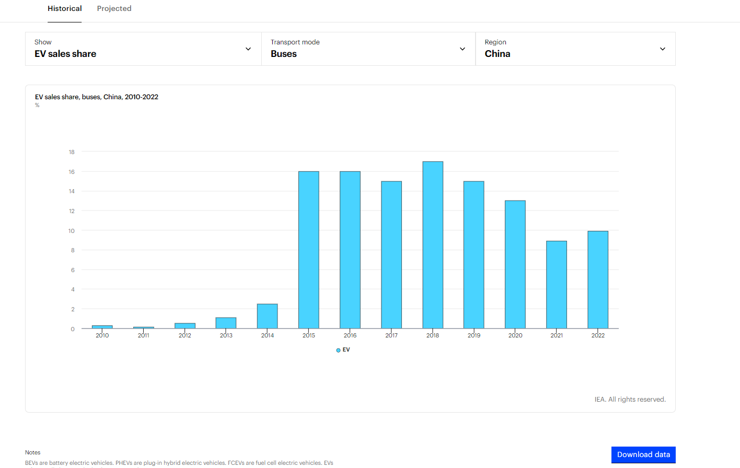

Slide 15
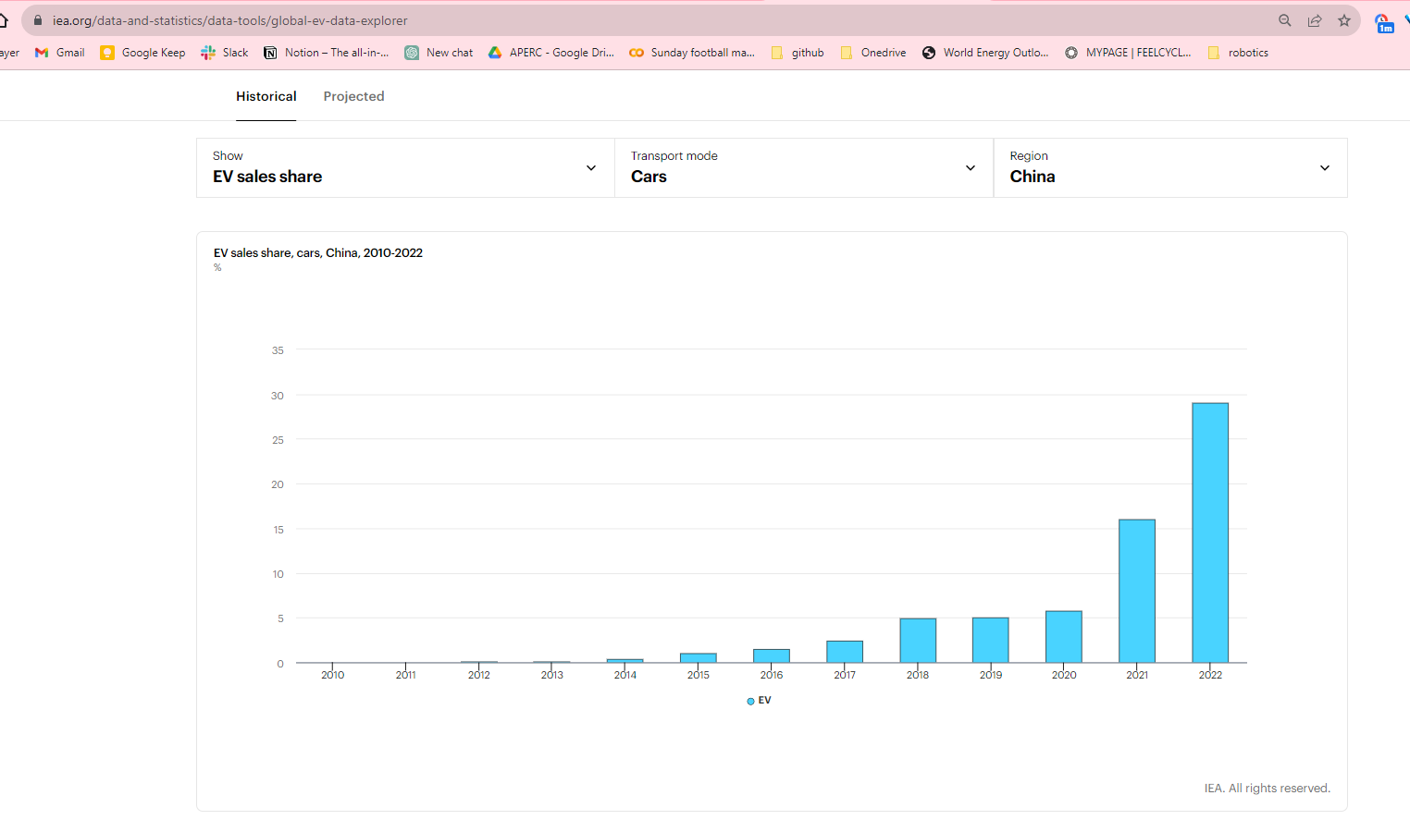

Slide 16
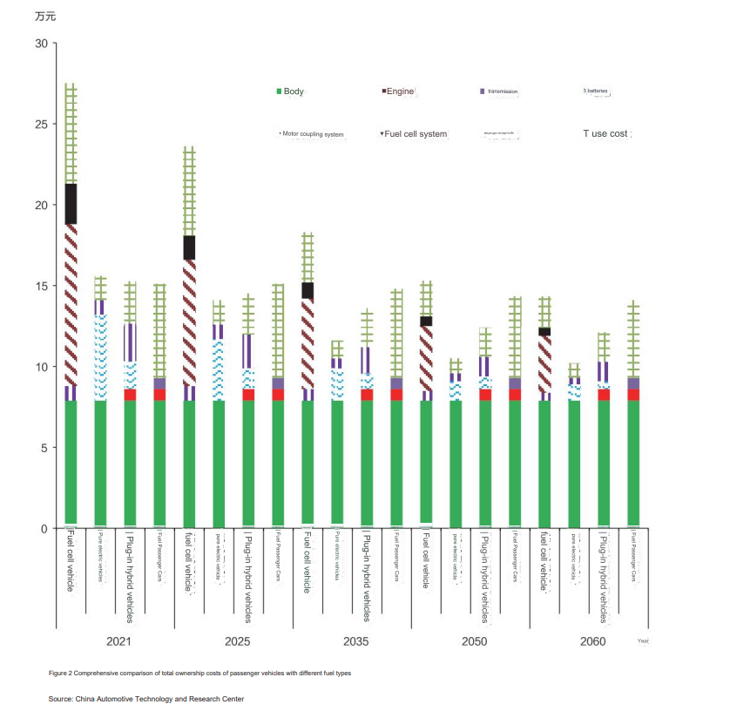

Slide 17
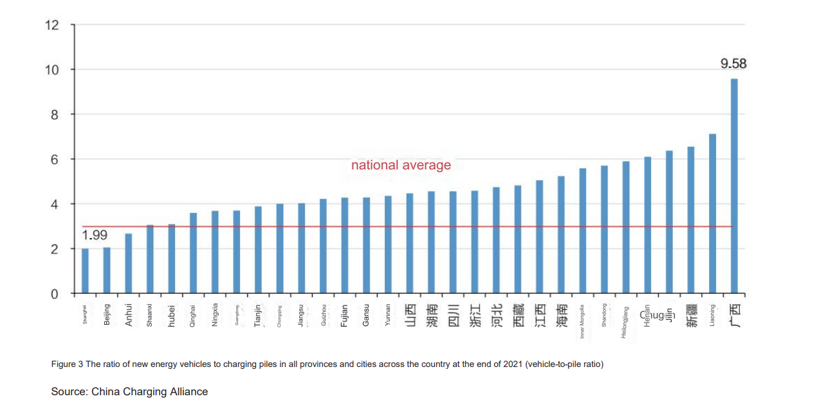

Slide 18
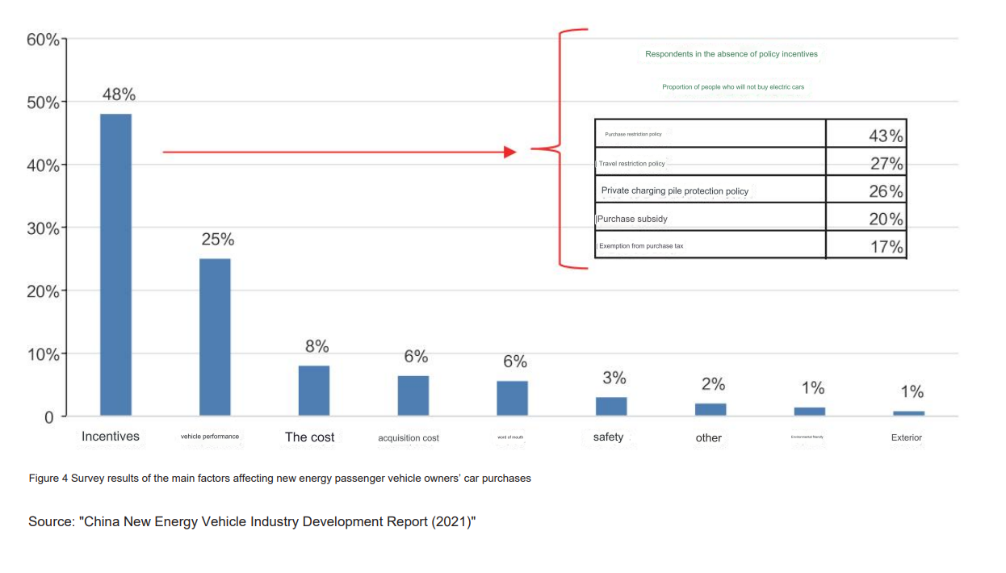

Slide 19
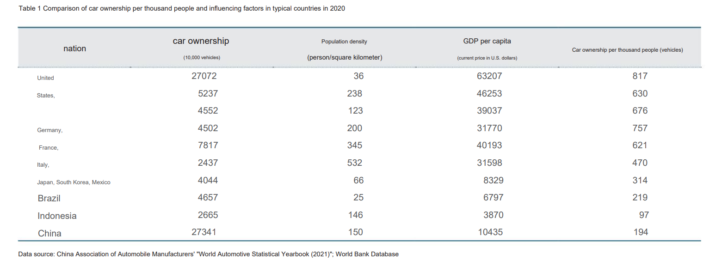

Slide 20
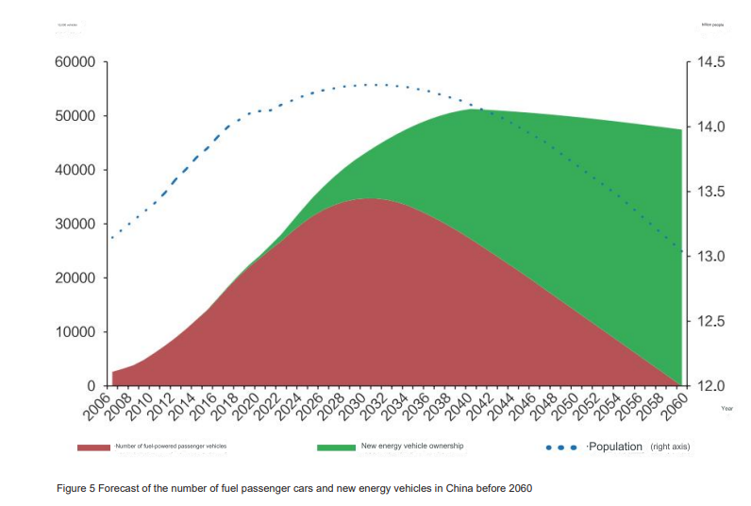

Slide 21
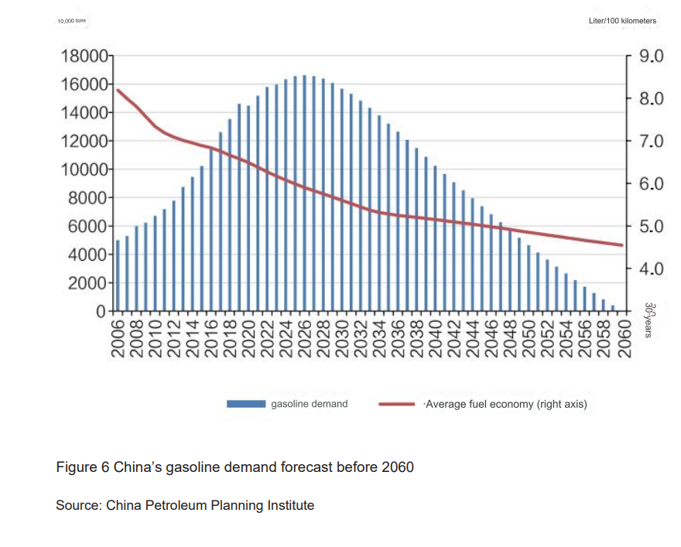

Slide 22
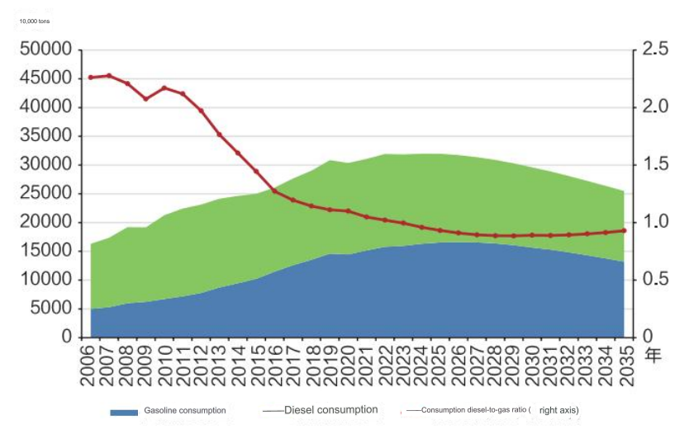

Slide 23
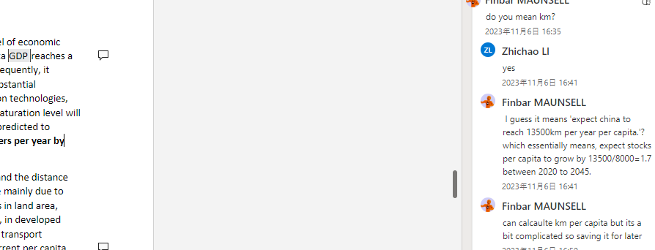
3.3 Transport
3.3.1 Analysis
Regarding passenger transportation, individual travel is closely related to the level of economic development. Data from the United States, Europe, and Japan show that per capita GDP reaches a saturated value of 15,000 to 20,000 kilometers per year at around $40,000. Subsequently, it experiences a slight decline. Considering China's level of per capita GDP km and its substantial population, coupled with the widespread adoption of long-distance communication technologies, which reduce the need for physical travel, it is expected that the domestic travel saturation level will be reached earlier than in advanced countries and at a relatively lower level. It is predicted to increase from the current 8,000 kilometers per year to 13,000 to 14,000 kilometers per year by 2040-2050.
Regarding freight transportation, turnover is influenced by the volume of goods and the distance they are transported. Differences in goods turnover among different countries are mainly due to variances in cargo consumption and transport distances resulting from differences in land area, resource structure, and industrial composition. Based on international experience, in developed countries, when per capita GDP reaches $30,000 to $40,000, the volume of goods transport generally reaches saturation, with a range of 40 to 70 tons per person. China's current per capita volume of goods transported is approximately 33 tons, indicating significant room for growth. It is expected to reach a saturation level of 40 to 50 tons per person around 2040.
In summary, around 2040, China's total transportation volume is expected to reach saturation, followed by a decrease in total transportation demand as the population declines and the demand for energy-intensive production materials(coal) diminishes. The peak in freight demand is expected to precede that of passenger demand.

Slide 24
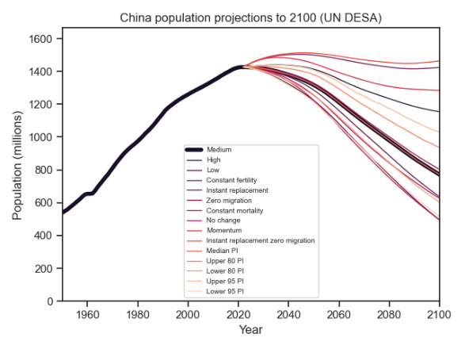
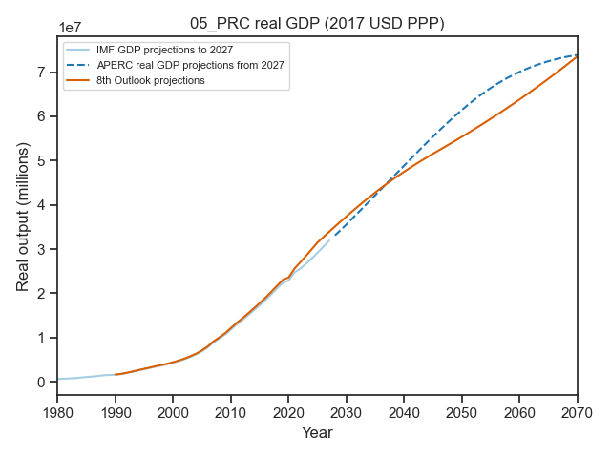
Km per capita at 2020 vs 2040/2050:
Gdp per capita at 2040/2050:
5/1400=0.0035
medium | measure | year
road | pKm | 2020
Road | pKm | 2040
road | pkm | 2050

Slide 25
Regarding freight transportation, turnover is influenced by the volume of goods and the distance they are transported. Differences in goods turnover among different countries are mainly due to variances in cargo consumption and transport distances resulting from differences in land area, resource structure, and industrial composition. Based on international experience, in developed countries, when per capita GDP reaches $30,000 to $40,000, the volume of goods transport generally reaches saturation, with a range of 40 to 70 tons per person. China's current per capita volume of goods transported is approximately 33 tons, indicating significant room for growth. It is expected to reach a saturation level of 40 to 50 tons per person around 2040.
In summary, around 2040, China's total transportation volume is expected to reach saturation, followed by a decrease in total transportation demand as the population declines and the demand for energy-intensive production materials(coal) diminishes. The peak in freight demand is expected to precede that of passenger demand.

Slide 26
With the introduction of electrification, efficiency improvements, a declining population after reaching its peak, and the continued maturation of the sharing economy, the growth rate of energy consumption in transportation is expected to slow down. It is projected to peak around 2030, at approximately 7.19 billion tce. Between 2020 and 2030, the annual growth rate will be approximately 1.64%, followed by a continuous decline. By 2060, it is expected to decrease to approximately 3.91 billion tce.
Tce to PJ:
1 tce to is 29.3076 gj or 2.9288E-5 pj
1 pj is a million gj
7.19billion tce = 231.823116 billion gj
= 231.823116 billion / 1e6 = 231k pj
7.19e9 * 2.92e-5 = 209,948

Slide 27
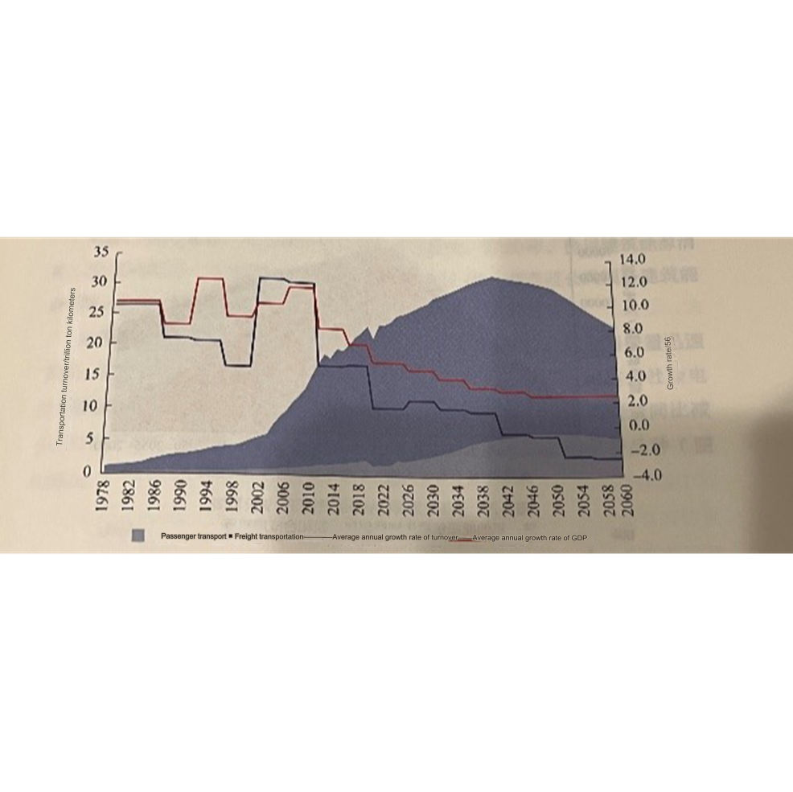
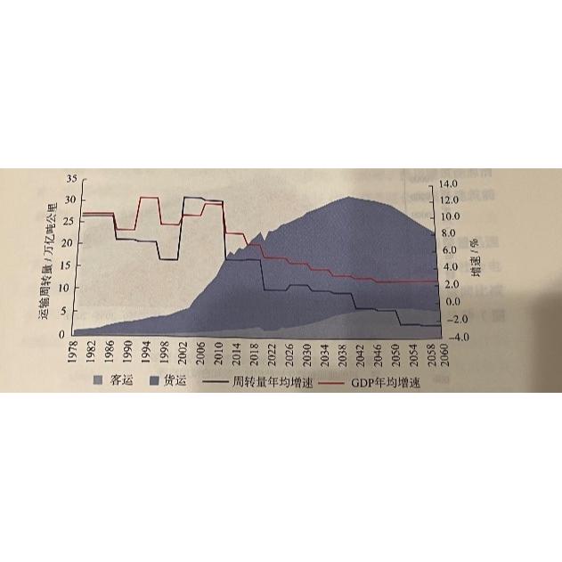

Slide 28
My own thoughts:
What to do about negative freight growth arising from gdp growth – x?
Doesn’t seem reasonable. But there are definite reasons to predict that freight growth rate.. i.e major freight use is coal transport in rail, but building power lines changes this.
Moving towards services economy decreases freight? Or does it stay the same and just not increase.
Also if theyre doing a lot of ccus in coal, the resulting captured c02 would be almost 2x the weight of the coal, so the transport would have to be 2x what it would’ve previously been for coal! (depending on the carbon content of coal and the c02 capture rate) < but this is probably pipeline! Good reason to consider pipeline?
Growth in non ferrous metals will not much impact on freight since they are more energy intensive in production. And make up a very small amount of freight anyways.
Construction expected to drop a lot. What could happen to exports? Could they keep production at same level
What to do about hydrogen? Should we match the graphs in next slide? They are from an author who is a bit biased (since he works in hydrogen).
Maybe I should decrease freight transport? Or at least stop it from taking up a share of road transport. Coal transport will probably decrease and its hard to say what could take up that?
Talk to junyue about how wat the assumptions (with not much info about ev shares) means for her work. Explain that its less about accurately predicting , but instead showing a scenario.

Slide 29
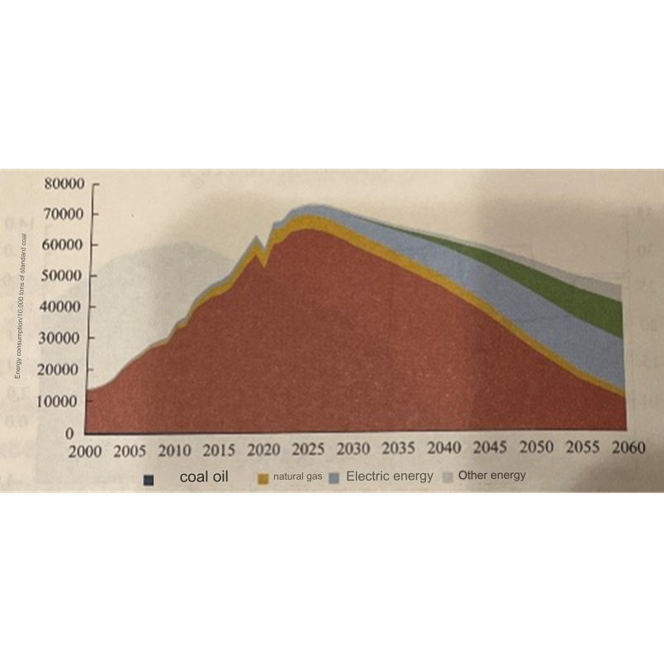


Slide 30
 | 2021 | REF | TGT
Energy Consumption |  | It is projected to peak around 2030, at approximately 7.19 billion tce. Between 2020 and 2030, the annual growth rate will be approximately 1.64%, followed by a continuous decline. By 2060, it is expected to decrease to approximately 3.91 billion tce.(Sinopec) | It is projected to peak around 2030, at approximately 6.69 billion tce. By 2060, it is expected to decrease to approximately 3 billion tce.

